Slide 1


CHENNAI
Skin Cancer Classification using Vision Transformers
Project Guide : Dr. E. Sudheer Kumar
Presented by : Manav Garg-21BAI1045

Slide 2



Problem Statement
Skin Cancer Diagnosis requires accurate differentiation between benign (Non-Cancerous, Not Harmful) and Malignant (Cancerous, Harmful) Skin Moles.
Traditional methods may struggle to capture the full context of an image.
Vision Transformers (ViTs) process images as sequences of patches, capturing global context through self-attention.

Slide 3


Fine-tuning pre-trained ViT models on the Processed Skin Cancer pictures, which includes both benign and malignant skin moles.
The Project Focuses on
Preprocess and augment the image dataset for better model training.
Evaluating the model's effectiveness using metrics like classification accuracy.
Comparing the ViT-based approach with existing methods to highlight potential benefits.

Slide 4
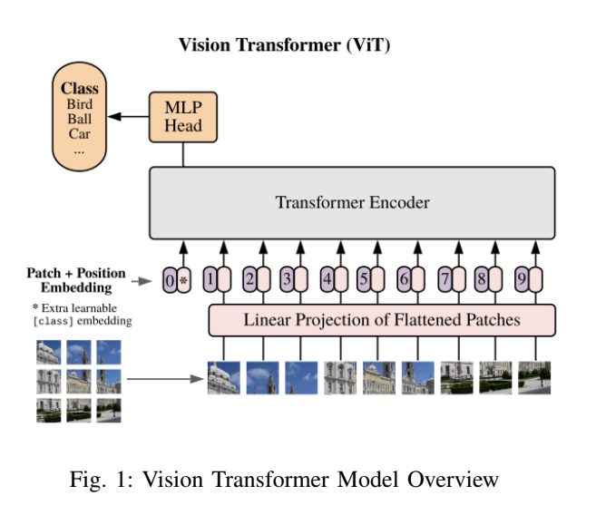
Introduction
Skin cancer is a prevalent and dangerous disease. Vision Transformers (ViTs) capture image context better than CNNs, potentially improving early and accurate diagnosis in medical settings.
This research evaluates Vision Transformers for skin cancer image classification, with a focus on differentiating benign from malignant lesions.

Slide 5
To evaluate Vision Transformers for classifying benign and malignant skin lesions.
Research
Objectives
To compare Vision Transformers' performance to CNN-based models.
To assess data augmentation's impact on model accuracy.

Slide 6
Proposed System Introduction
The system uses Vision Transformers, trained on skin lesion images. Data augmentation techniques improve the model's robustness and generalization, allowing it to differentiate between benign and malignant lesions.

Slide 7
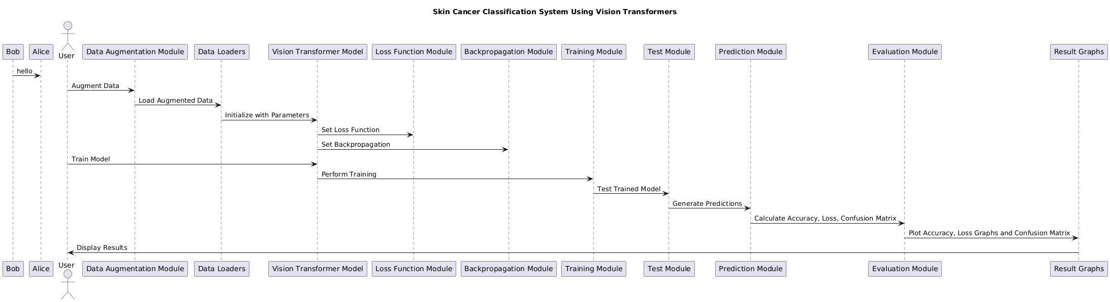
Proposed System Diagram

Slide 8
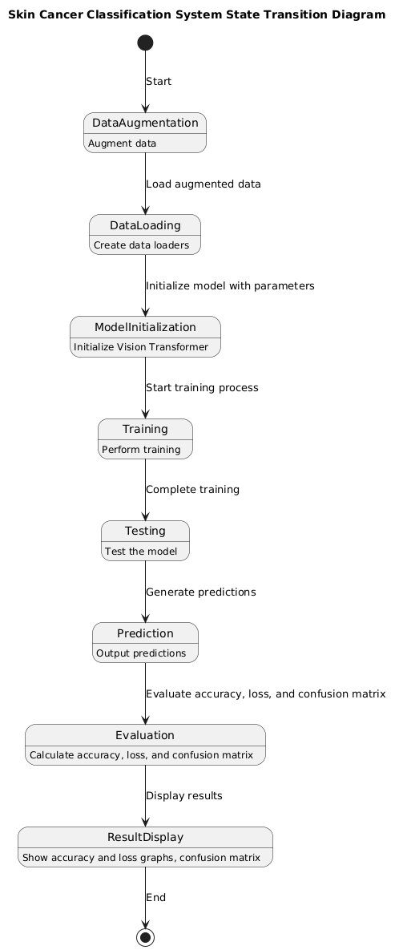
State
Transition
Diagram

Slide 9
az
Data Collection and Preparation
Data Augmentation
List of Modules
Model Selection
Training and Evaluation
Interpretation of Results

Slide 10
Data Collection and Preparation
The dataset used in this study consists of 1,800 images each of benign and malignant skin moles, sourced from the ISIC Archive.
These images were resized to a uniform 224x224 pixels and normalized. The dataset was split into training and test sets, with 80% for training and 20% for testing.

Slide 11
Data Augmentation
Data augmentation was applied to increase the diversity of the training dataset and improve the model’s generalization.
Techniques included random horizontal flipping, rotation, color jittering, resized cropping, affine transformations, and perspective transformations.
This augmented dataset reduced dependency on large data volumes and helped prevent model overfitting.

Slide 12
Model Selection
Vision Transformers (ViTs) were chosen over traditional Convolutional Neural Networks (CNNs) for this study due to their capacity for capturing global context in images.
Two variations were used: a Base Vision Transformer and a Deep Vision Transformer, each with specific configurations tailored for skin cancer classification.

Slide 13
Interpretation of Results
The Base Vision Transformer achieved high accuracy with data augmentation, highlighting the importance of diverse training data.
However, some misclassifications indicated that the model struggled with similar-looking benign and malignant lesions.
This suggests that additional refinements are needed to enhance feature robustness for better discrimination between these classes

Slide 14
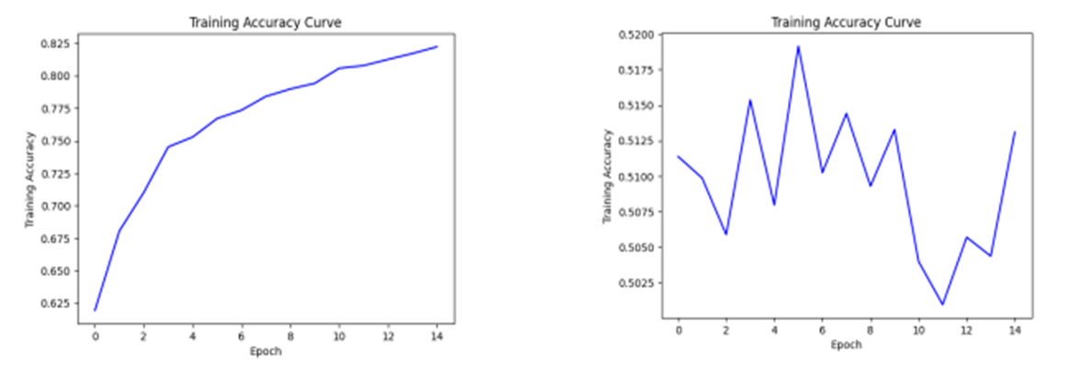
For Augmented Data, the training accuracy graphs for both Base Vision Transformer (Fig. 1) and Deep Vision Transformer (Fig. 2) are as follows
Accuracy Graphs
(Fig. 1)
(Fig. 2)

Slide 15
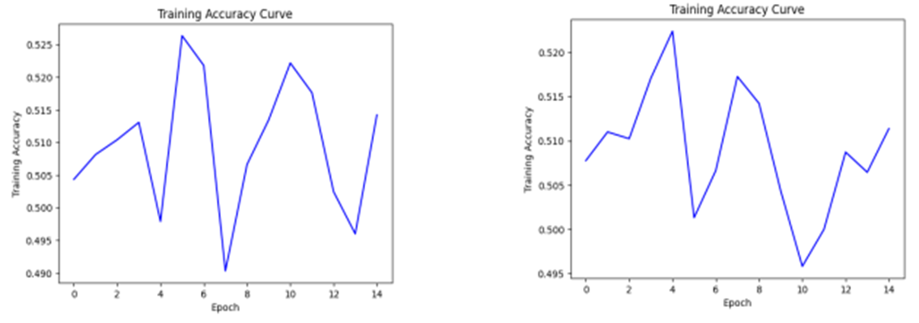
For Non - Augmented Data, the training accuracy graphs for both Base Vision Transformer (Fig. 1) and Deep Vision Transformer (Fig. 2) are as follows
Accuracy Graphs
(Fig. 1)
(Fig. 2)

Slide 16
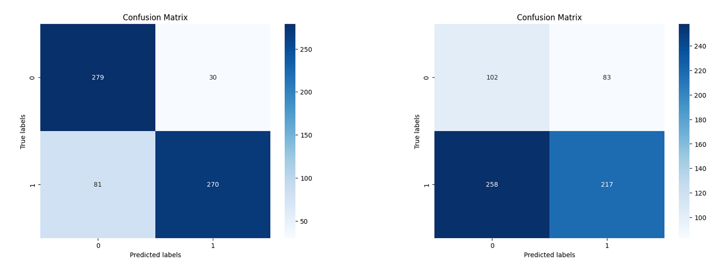
For Augmented Data, the confusion matrices for both Base Vision Transformer (Fig. 1) and Deep Vision Transformer (Fig. 2) are as follows
Confusion
Matrices
(Fig. 1)
(Fig. 2)

Slide 17
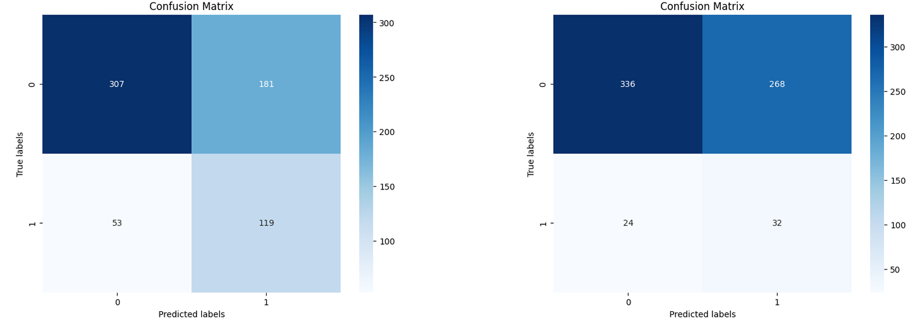
For Non - Augmented Data, the confusion matrices for both Base Vision Transformer (Fig. 1) and Deep Vision Transformer (Fig. 2) are as follows
Confusion
Matrices
(Fig. 1)
(Fig. 2)

Slide 18
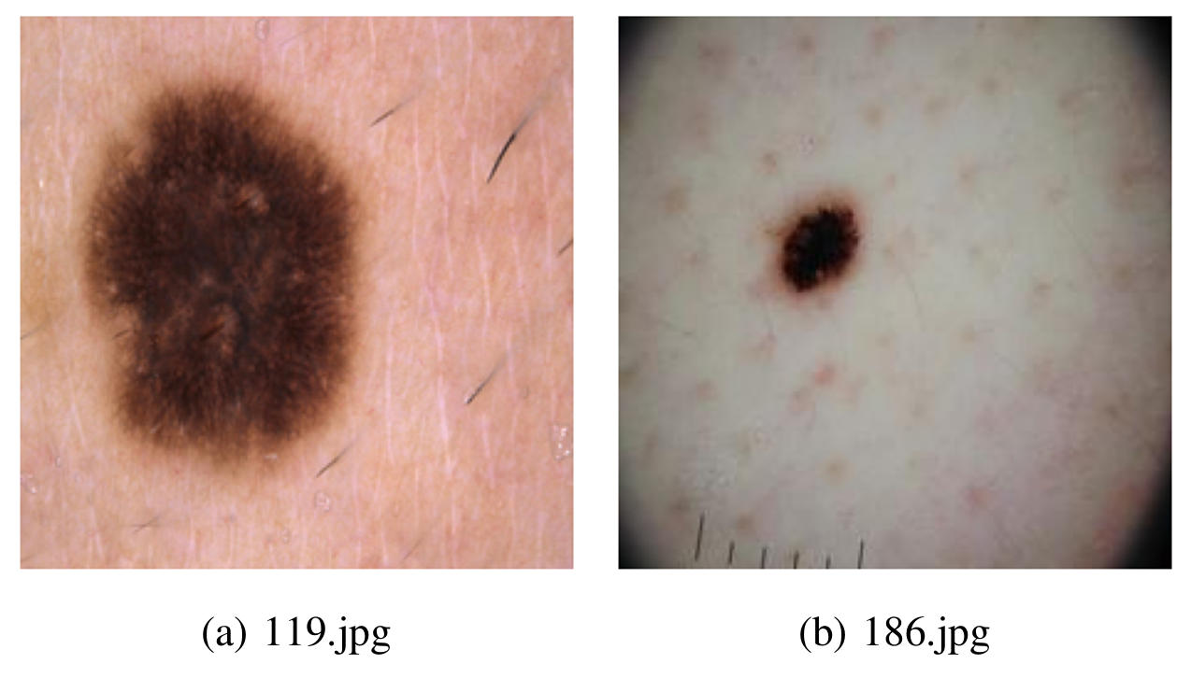
Interpretation
The Base Vision Transformer achieved high accuracy with data augmentation, highlighting the importance of diverse training data.
However, some misclassifications indicated that the model struggled with similar-looking benign and malignant lesions.
Misdiagnosed Images from the dataset

Slide 19
Future Work - Next Steps
Refine the model with additional training data.
Experiment with further tuning and alternative configurations.
Validate model on external datasets to check generalizability.
Research and add/use more references

Slide 20
References
[1] A. Dosovitskiy, L. Beyer, A. Kolesnikov, D. Weissenborn, X. Zhai, T. Unterthiner, M. Dehghani, M. Minderer, G. Heigold, S. Gelly, J. Uszkoreit, and N. Houlsby. An image is worth 16x16 words: Transformers for image recognition at scale. 2020.
[2] C. en Amy Tai, E. Janes, C. Czarnecki, and A. Wong. Double-condensing attention condenser: Leveraging attention in deep learning to detect skin cancer from skin lesion images, 2023.
[3] A. Faghihi, M. Fathollahi, and R. Rajabi. Diagnosis of skin cancer using vgg16 and vgg19 based transfer learning models, 2024.
[4] A. Hassani, S. Walton, N. Shah, A. Abuduweili, J. Li, and H. Shi. Escaping the big data paradigm with compact transformers, 2022.
[5] G. M. S. Himel, M. M. Islam, K. A. Al-Aff, S. I. Karim, and M. K. U. Sikder. Skin cancer segmentation and classification using vision transformer for automatic analysis in dermatoscopy-based non-invasive digital system, 2024.
[6] H. Touvron, M. Cord, M. Douze, F. Massa, A. Sablayrolles, and H. J´egou. Training data-efficient image transformers distillation through attention. 2021.
[7] L. Yuan, Y. Chen, T. Wang, W. Yu, Y. Shi, Z. Jiang, F. E. Tay, J. Feng, and S. Yan. Tokens-to-token vit: Training vision transformers from scratch on imagenet, 2021.
[8] D. Zhou, B. Kang, X. Jin, L. Yang, X. Lian, Z. Jiang, Q. Hou, and J. Feng. Deepvit: Towards deeper vision transformer, 2021

Slide 21
Vision Transformers (ViTs) are utilized in skin cancer classification by first dividing images into fixed-size patches, treating each patch as an individual token.
These patches are then linearly embedded into vectors, transforming the image into a sequence of vectors.
The self-attention mechanism within the ViT model processes these vectors, capturing the global context and relationships between patches.
This approach allows the model to focus on relevant features across the entire image, improving its ability to accurately classify skin moles as benign (non-cancerous) or malignant (cancerous).
Conclusion

Slide 22
Thank You!

